Slide 1




BDM Capstone Project [May 2025]
Business Performance Analysis for a Local Hardware Store
by Manjusha Pundkar [23F1001645]

Slide 2
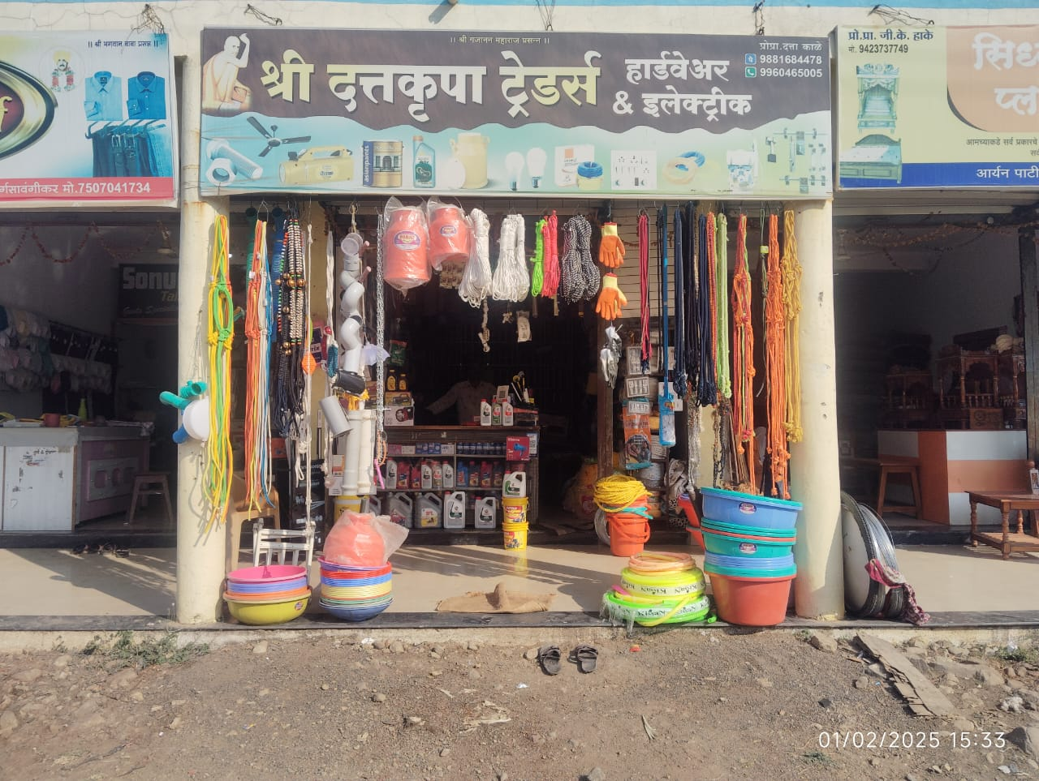
The Business and The Problems
About the Business
Name of the Business: Shree Dattakrupa Traders
Type of Business: B2C Retail shop, specialising in Farming and construction related materials
Location: Hingoli, Maharashtra, India
Founder: Mr. Dattatraya Kale
Background: The shop was founded in 2013 by the founder, after working in Tata Motors for a while.
Problems
Manual Inventory Tracking – Stock is tracked through memory and handwritten notes, which often leads to stockouts of fast-moving items and overstocking of slow-moving ones.
No Structured Sales Analysis – The shop owner has no insights into which products or categories drive the most revenue, making business decisions based on assumptions.
Lack of Customer Retention Strategy – There is no system to track loyal customers or offer them incentives, leading to missed opportunities for repeat business.
Pricing by Intuition – Product prices are set based on guesswork instead of data or competitor benchmarking, which results in inconsistent profit margins.

Slide 3






Data Cleaning and Preprocessing
Before going ahead with the analysis part it was necessary to clean and preprocess the data. A series of preprocessing operations were carried out on the dataset making the data eligible for the data analysis operations.
Data
Cleaning
SKU
Clustering
Category Classification
Quantity Standardisation
Data
Organization
Duplicate bills, incorrect spellings, etc errors were rectified
SKUs were clustered into similar types of SKUs using OpenRefine
46 SKUs were classified into 6 major categories.
The quantities were standardised to a common level of measurement.
Data was further orginised for analysis.

Slide 4






Objective and the Methods
Objective: The aim of the project is to analyse the extracted data and draw out actionable insights that may help the business to boost up their sales and build a strong brand image in the market.
Methods of Analysis: After a rigorous data cleaning and preprocessing operation, 5 methods of analysis were deployed on the preprocessed dataset to uncover categorical sales influence, product performance, customer behaviour and future sales trends.
Categorical Sales Influence
SKU Performance Classification
Market Basket Analysis
Customer
Insights
ARIMA Sales Forecasting
To understand the influence of each category on total sales
To identify which SKUs are the drivers of business, contributing the most towards the growth of the business.
To identify products that are frequently bought together, helping us understand customer behavior.
Understand customer insights and try to identify possible solutions.
Create a model, capable of predicting the future sales values the business can experience in the following months.

Slide 5

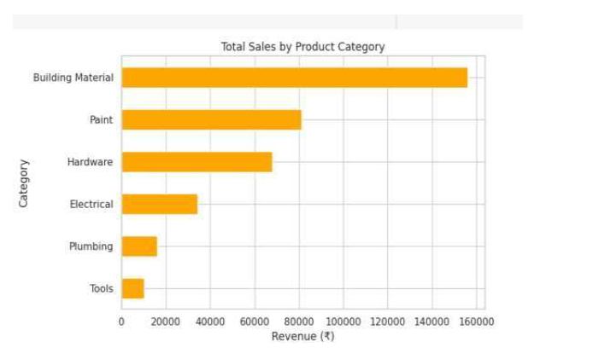
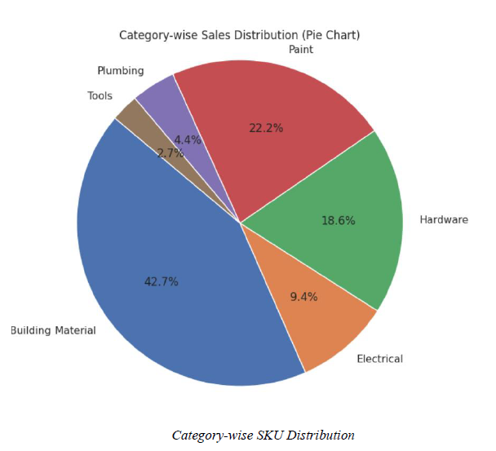
ANALYSIS 1
Categorical Influence on Sales
Explanation
Compared revenue by product category and also calculated revenue per SKU to see which categories are actually strong.
This analysis was done to understand how much each product category contributes to the shop’s revenue. Instead of only looking at total sales, I also calculated revenue per SKU (sales density) so that categories with fewer products but higher value (like Building Materials) are not overshadowed by larger categories (like Paint). This gave a fairer picture of which categories are truly the most important for the business.
Results and Findings
Building Materials = highest revenue and revenue per SKU (cement, tile adhesive).
Paint & Hardware = medium influence.
Plumbing & Electrical = low revenue, bought occasionally.

Slide 6
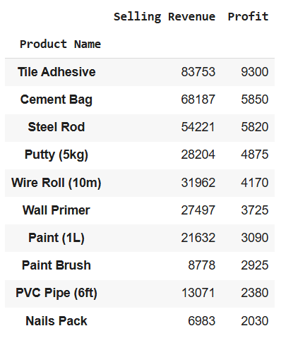
ANALYSIS 2
SKU Performance Classification
Explanation
ABC Analysis was used to classify 46 SKUs into 3 classes based on sales and quantity: Good Performers, Medium Performers, and Poor Performers.
Used ABC analysis (70-20-10 rule) to classify products based on revenue contribution.
Results and Findings
Class A: Cement, Tile Adhesive, Steel Rod, Wire Roll → top 70% of sales.
Class B: Wall Primer, Putty, Paint, PVC Pipe → moderate (20%).
Class C: Paint Brush, Nail Pack → very low (10%).

Slide 7
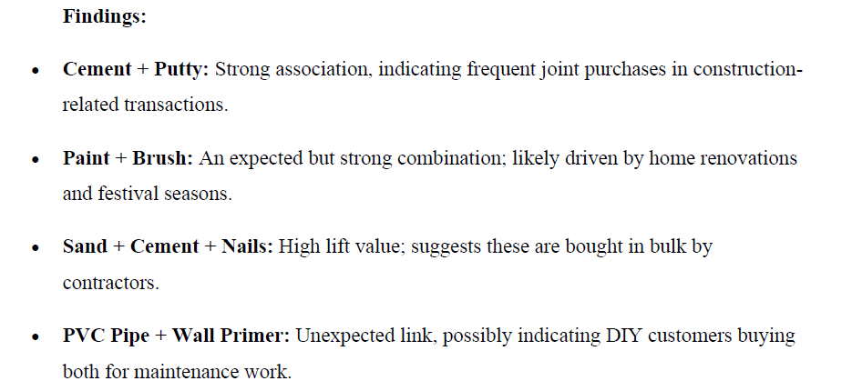
ANALYSIS 3
Market Basket Analysis
Explanation
This method was used to find which products are frequently purchased together. The Apriori algorithm was applied with a minimum support of 2% and confidence greater than 0.2. It helped identify strong associations between products, showing common combos that customers usually buy in the same transaction.
Results and Findings
Cement + Putty = frequent construction combo.
Paint + Brush = renovation combo.
Cement + Sand + Nails = contractor bundle.
PVC Pipes + Wall Primer = DIY Bundle

Slide 8
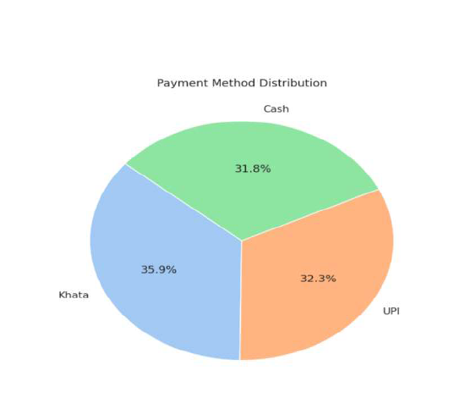
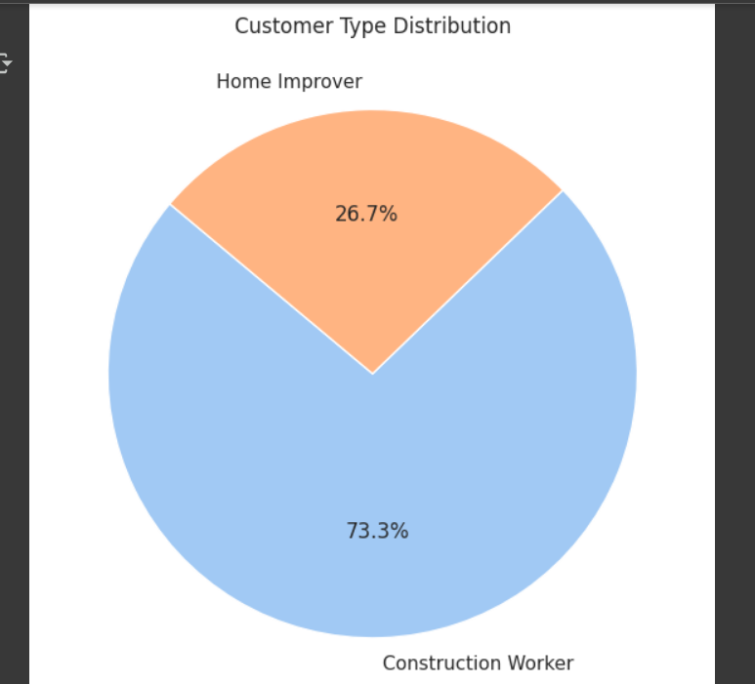
ANALYSIS 4
Customer
Insights
Explanation
Customer details were analyzed using the dataset fields “Customer Type” (contractor, farmer, homeowner, etc.) and “Payment Method” (Cash, UPI, Khata/Credit). The aim was to understand who contributes the most to revenue, their buying behavior, and how they prefer to pay.
Results and Findings
Contractors – Contributed most of the total revenue through bulk purchases, but nearly 36% of their transactions were on credit(Khata), causing cash flow delays.
Walk-in Customers – Made smaller, need-based purchases (paints, pipes, nails) and usually paid through cash or UPI, giving instant revenue.
Payment Methods – Overall, Khata (36%), UPI (32%), and Cash (32%) were almost equally used, showing a high dependence on credit compared to digital or cash payments.

Slide 9
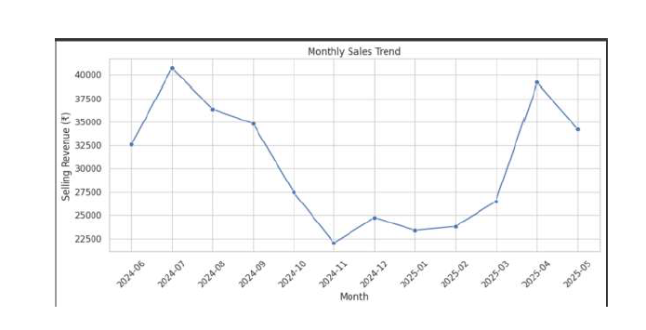
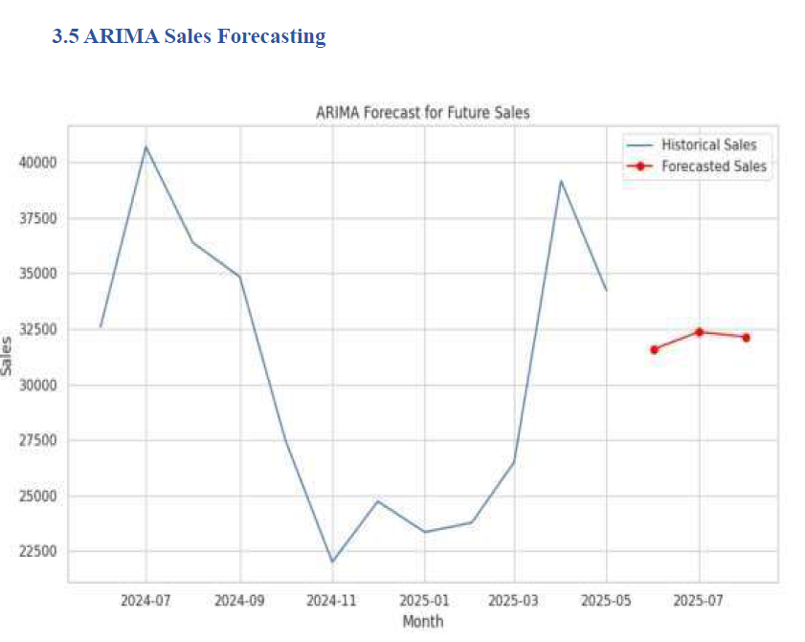
ANALYSIS 5
ARIMA Sales Forecasting
Explanation
Using the dataset spanning 12 months, a well functioning ARIMA Model was trained, after interpolating the missing values in the dataset.
I checked if my data can be used for ARIMA. Then I selected p=1, d=1, q=1 from the graphs and trained the model to forecast sales.
Results and Findings
ARIMA forecast → stable sales ₹30k–₹32k/month, peaks in Jun–Jul, dips in Jan–Feb.
I trained the model on past sales, and then forecasted the next 3 months.
The red line in my graph shows the predicted sales. This helps the shopkeeper plan stock in advance.

Slide 10
Recommendations
1
Keep more focus on Class A products – Items like cement, tile adhesive, steel rods, and wire rolls are the shop’s main revenue drivers. These should always be available in stock, as running out of them directly affects sales and customer trust.
2
Create bundle offers for commonly bought items – Since customers often purchase cement with putty, and paint with brush, the shop can introduce combo packs or small discounts when these are bought together. This will increase average billing value and attract repeat buyers.
3
Introduce a simple contractor loyalty plan – Contractors generate more than half of the revenue, but most of their purchases are on credit. Giving them small loyalty rewards like discounts, free delivery, or priority service can keep them engaged while encouraging them to pay faster, especially if paired with UPI/cash discounts.
4
Plan inventory based on seasons – Sales are higher in monsoon and festival months (Jun–Jul) and dip in Jan–Feb. So, the shop should increase stock before peak months and run clearance or discount offers in low-demand months. This will help balance cash flow and avoid excess unsold stock.
5
Manage slow-moving products smartly – Items like paint brushes and nail packs don’t contribute much to revenue. Instead of letting them occupy space, they can be bundled with bigger purchases or even discontinued if they don’t improve. This will free up money and storage for better-selling items.
6
Growth Plan - Expand high-demand product categories based on forecast trends.
7
Financial Discipline - Reduce long credit cycles; encourage UPI/cash.

